Slide 1
Implementation of Augmented Reality for Digital Classroom Applications
Team members:
P.Chinmayee(17B91A12C7)
V. Bala Saraswati (17B91A12H1)
V. Bharathi Sri(17B91A12G7)
P. Sowmya(17B91A12D1)
Guide Name:
Sri B.V.D.S.Sekhar
Associate Professor
Dept of IT
Department of Information Technology
Sagi Rama Krishnam Raju Engineering College, Bhimavaram.

Slide 2

Table of Content:
Introduction
Problem Statement
Existing System
Proposed System
Literature Survey
Methodology

Slide 3
Introduction:
Augmented reality (AR) has quickly become one of the most popular trends among software and hardware developer. User maintains a sense of presence in real world.
AR allows people to interact with their real-world environment in an enhanced way. A combination of a real scene viewed by a user and a virtual scene generated by a computer.
AR can promote interactive experiences with coursework, encourage collaboration between students, improve motivation, and increase learning gains.

Slide 4

Problem Statement:
Presenting corresponding lecture videos while teaching an online class is a major difficulty for lecturers. An automated Augmented reality app is designed in-order to ease their task. This app recognizes the hand gestures or image cards and plays the corresponding video to the students. In this way the task of lecturers to present the corresponding video without giving a pause to lecture becomes very easy. Lecturers can show the image cards to play a related video.

Slide 5
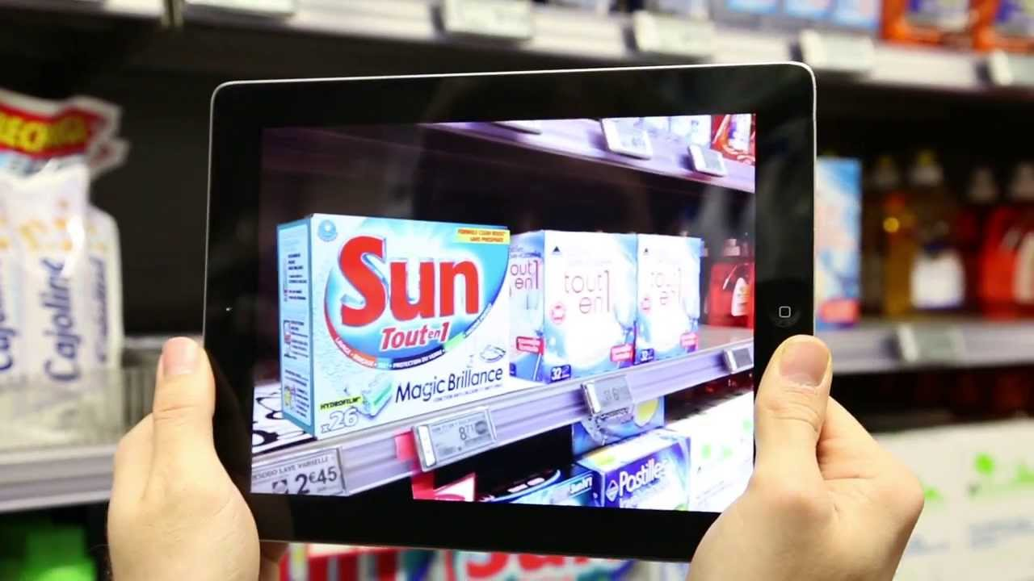
Existing System
In the existing Augmented Reality system we login into the user interface and scan an object with the camera, this will be compared with the images in the database and the details of the object in the database which is similar to scanned image, will be provided as the output in the user interface.
This system only provides the details of the object but what we aim in our project is to retrieve a video to a corresponding hand gesture.

Slide 6
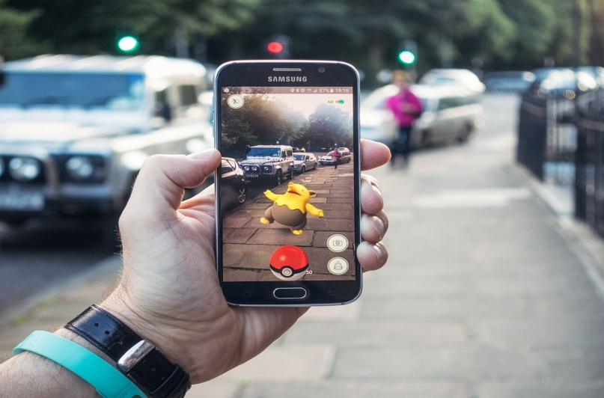
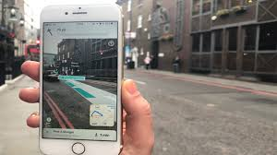
Existing System:

Slide 7
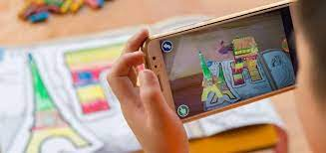
Proposed System:
In this system, an application for the digital classroom is presented. Teacher can show virtual videos on the screen with the help of unique image cards. This is achieved using Feature detection and matching. Feature detection and matching is an important task in many computer vision applications, such as structure-from-motion, image retrieval, object detection, and more. A feature is a piece of information which is relevant for solving the computational task related to a certain application. Features may be specific structures in the image such as points, edges or objects. The best role for augmented reality is as a supplementary tool. So, teachers can use it to bring lessons to life. Augmented reality is best suited to enhancing those traditional lessons.

Slide 8
Literature Survey:
TITLE | AUTHORS | DESCRIPTION | YEAR
Augmented Reality as a Resource for Improving Learning in the Physical Education Classroom | Antonio-José Moreno-Guerrero , Santiago Alonso García , Magdalena Ramos Navas-Parejo ,María Natalia Campos-Soto and Gerardo Gómez García | They used the parameters like data of participants with a total of 140 students in the subject of physical education. The sample generation technique has been applied in educational centers. | 2020
Augmented reality in teacher education. A framework to support teachers’ technological pedagogical content knowledge | Josef Buchner and Jörg Zumbach | They used the Technological Pedagogical Content Knowledge (TPCK) to review of the research literature on AR learning environments reveals that in most studies AR contributes to successful learning and increased motivation. | 2020

Slide 9
TITLE | AUTHORS | DESCRIPTION | YEAR
A Semantic Platform for Open Educational Augmented Reality Resources | Christian Grevisse, Carina Martins Gomes, Steffen Rothkugel | They used the Open Educational Resources (OER) has enabled the sharing of heterogeneous learning resources. Their retrieval can be improved by enriching their metadata using Semantic Web technologies. | 2020
Augmented Reality in Mobile Devices | Faculty of the Department of Software Engineering San JosState University In Partial Fulfillment of the Requirements for the Degree Master of Science By Sneha Kasetty Sudarshan May | They used some software frame works like Wikitude,Nexus, UMAR,DWARF, KHARMA,ALVAR, CloudRidAR by developers to focus on developing their high-level applications. | 2018

Slide 10
TITLE | AUTHORS | DESCRIPTION | YEAR
Recreation of history using augmented reality | Nilam Desai Assistant Professor, Smt. Chandaben Mohanbhai Patel | The parameters used in here are some images of historical objects for rebuilding of historical object to have realist view of time using Augmented Reality perceptrons. | 2018
Using augmented reality technologies for STEM education organization | V.V.Osadchyi , N.V.Valko2 and L.V.Kuzmich | The use of augmented reality technology improves the learning of individual students, their motivation, As the topic of augmented reality in education is quite new and little studied for STEM education | 2020

Slide 11
Methodology:
Authenticating the lecturers into the app.
Processing the image card or gesture shown by the lecturer.
Analyzing the image card and performing feature detection.
Comparing features of this image card with those in the database.
Presenting the video corresponding to the most similar image in the database .

Slide 12

Start App
Flow Chart:
Activate Camera Sensor
Stop
yes
Identify the Image card or gesture
Exit?
No
Extract the features
Comparison
Display the video
Get user action

Slide 13

Thank you.

